Slide 1
HealthTech Net September 20, 2013
John M. (Jay) Shiver, MHA, LFACHE, FAAMA
Assistant Professor
Health Administration and Policy

Slide 2
Thidwick – our healthcare system

Slide 3
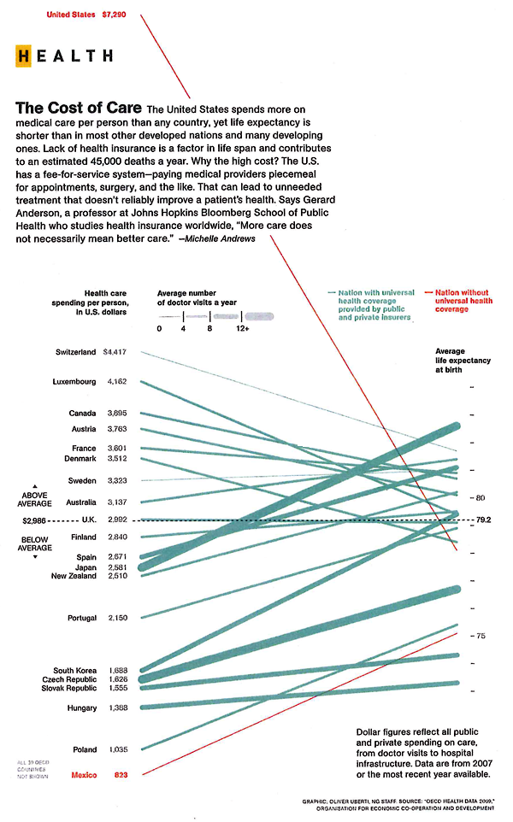
Everything Costs More Why is this any Different?
This cost is
covered somewhere

Slide 4
Growth Per Capita, Compared to Prior Year
The recession
isn’t the only reason
for the change.
 | 1990 | 2000 | 2007 | 2008 | 2009 | 2010 | 2011
NHE | 9.9 | 5.5 | 6.6 | 3.7 | 3 | 3.1 | 3.1
GDP | 6.6 | 4.4 | 4.1 | 0.9 | -3.1 | 2.9 | 3.2
NHE = National Health Expenditures GDP= Gross Domestic Product
Source: Hartman et al. "National Health Spending in 2011" Health Affairs Jan 2013

Slide 5
Medicare and Medicaid Spending Also Decreasing
 | 2005 | 2006 | 2007 | 2008 | 2009 | 2010 | 2011
Medicare | 9.2 | 18.8 | 7.4 | 8 | 6.9 | 4.3 | 6.2
Medicaid | 6.4 | -0.9 | 6.3 | 5.8 | 8.8 | 5.9 | 2.5
Source: Cutler D., Shani, N. "The Forecast Slowdown in Medicare Spending" Journal of the AMA 2/21/13

Slide 6
End of Life Care Costs
– surrogate for comparative costs by state
DC
MD
VA

Slide 7
Questions for Today
OK, So it’s down a bit?
Is this just a trend?
Is it sustainable?
What will it take to maintain?

Slide 8
It is about the attitude
Politically everyone seems to concur that continued cost growth is not sustainable,
Differences arise relative to how to change
There are reasons it is not easy
Deep seated self interests – top to bottom
Perhaps most complex business model
It is not just about the money
Do not forget:
Our system does
what we pay
the it to do

Slide 9
Some thoughts about Status Quo
The healthcare system is comprised of people trying to do the right things
Many efforts have been successful in reducing costs, improving health, extending useful fruitful lives, making us healthier longer.
Science, technology, “re-engineering process” creating new professionals….all have helped.
However the basic malaligned structure remains: we pay the system to heal us & ya gotta be sick to be healed

Slide 10
Challenges and Changes
Partisanship Hurts
We all seem to agree we can’t stay the course
This issue is too large for fear mongering
There’s a model to work with, start there

Slide 11
Challenges and Changes
Clinicians need lead the effort
This is a complex science
Financial bullying starts a fight
Those in the trenches, physicians especially, know the total costs of care and the consequences
Give them truthful, transparent financial and quality data
Keep the financial incentives focused on quality and outcomes

Slide 12
Challenges and Changes
Solutions may not be universal
Healthcare is local but there are unjustifiable variations
Local cultural differences do influence health
Local financial issues matter

Slide 13
Challenges and Changes
Engage the consumers
Personal responsibility will come into play
We saw what fear of change can do before:
remember the “death panels?”

Slide 14
Closing thoughts
There ain’t no magic silver bullet
There are opportunities out there
Society needs your help
Technology will play a lead role
Focus on outcomes

Slide 15
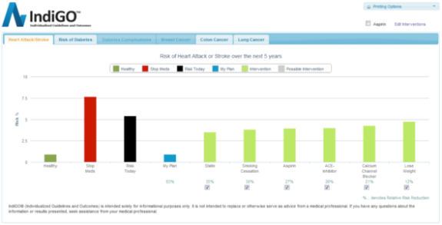
Examples of “New” Healthcare
http://www.youtube.com/watch?v=vcdzP4dX-dE

